Slide 1

Project On-shelf Availability

Slide 2


INTRODUCTION
Introducing a cutting edge technology to solve the problem of On-shelf Availability
Development of AI model to correctly identify and measure the empty space on the retail shelves using breakthrough technologies such as computer vision and deep learning
Based on customizable threshold values for shelf emptiness, store supervisors will receive notifications regarding the necessary actions to be taken

Slide 3


SCOPE OF WORK
SCOPE OF WORK
KEY DELIVERABLES
Object Detection Model
Web Application Deployment
Tableau Dashboard
With the coming of age of Artificial Intelligence, everyone wants to see how they can use their data to solve their business problems. Some Brick and Mortar stores are silently working on how they can stay competitive by predicting empty supermarket shelves. This leads to the idea that the store can automatically track empty shelves in the store, and take the guesswork out stocking.
.

Slide 4
Issues Arising from Empty Supermarket Shelves
Customer Dissatisfaction
Missed Revenue Opportunities
Wasted Operational Efforts
Negative Store Image

Slide 5
Object Detection and Localization: Develop an advanced system capable of accurately identifying and localizing products and spaces present on store shelves
Space Utilization Analysis: Calculate the percentage of available space to understand how much shelf space is occupied by products and how much is available for restocking
Actionable Restocking Insights: Generate actionable insights based on the space utilization analysis
OBJECTIVEs

Slide 6
Project Development Stages
Data Requirement
Data Collection
Annotation
Data Pre-Processing
Model-Building
Hyper-Parameter Tuning
Space-Calculation
Real-Time tracking
Deployment & Reporting

Slide 7
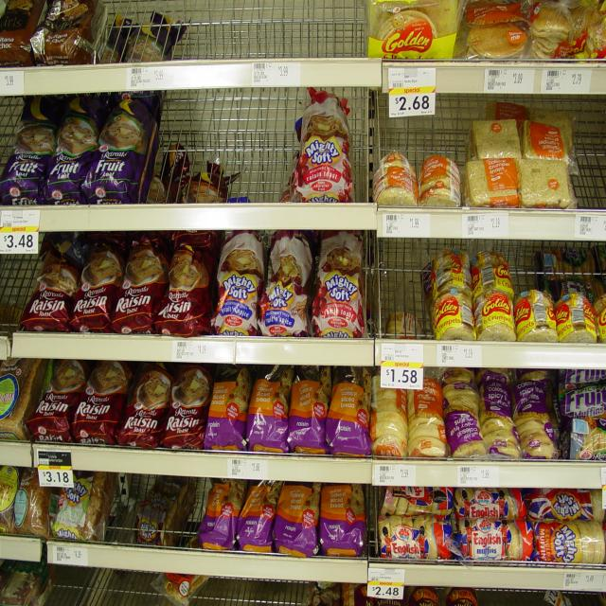
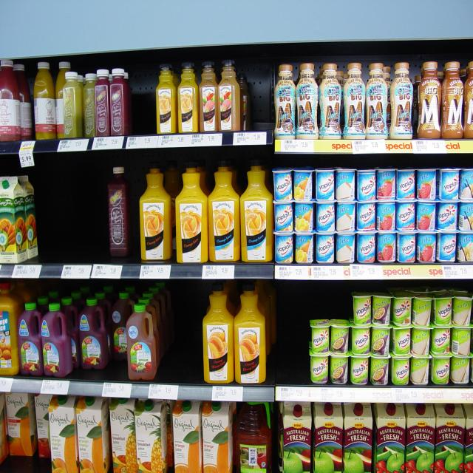
Project Development Stages
Step 1: Data Requirements
Clear, high-resolution images showcasing diverse retail store shelves, encompassing various shelving types and designs
Step 2: Data Collection
Collected a dataset of 300 images from the Kaggle website
Sample Images

Slide 8
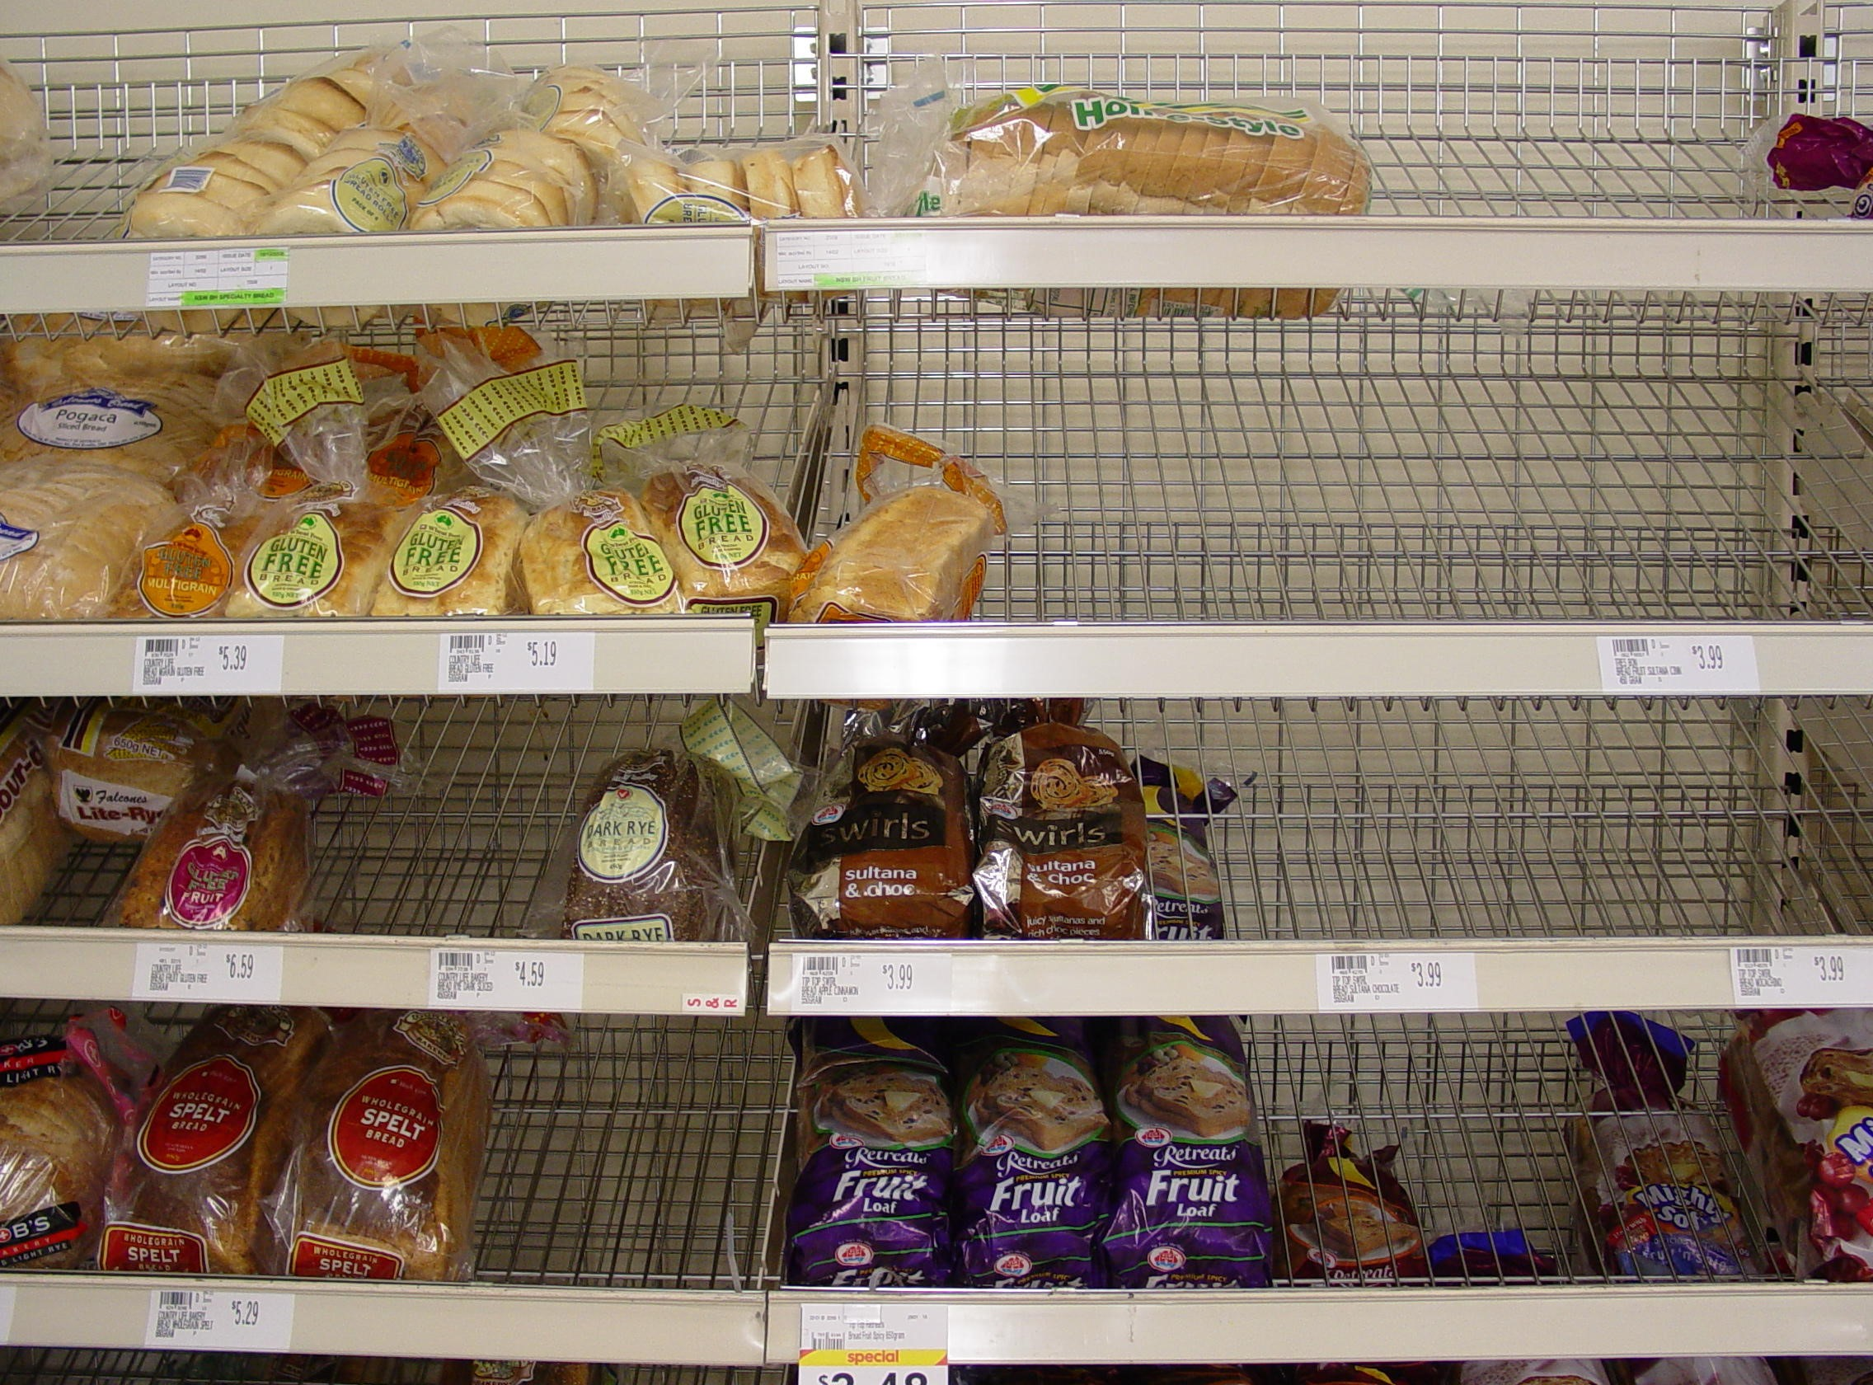
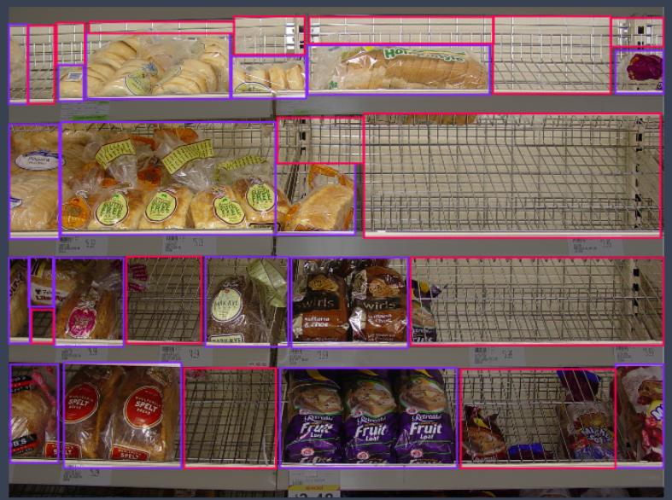
Project Development Stages
Step 3: Annotation
Annotated images using the online platform Roboflow
Object
Space
Before Annotation
After Annotation

Slide 9
PROJECT DEVELOPMENT STAGES
Step 4: Data-Preprocessing
Resized to 640x640
Divided into Train, Test, Validation
Annotations converted to Yolo required bounding box format
Step 5: Model Training
Trained using YOLOv8
Model Evaluation-mAP@50
Step 6: Hyperparameter tuning
Model | Epochs | Patience | Batch | Optimizer | Seed | momentum | box loss gain | class loss gain | dfl loss gain | Label smoothing |  | mAP50
Yolov8n | 20 | 3 | 16 | auto | 25 | 0.97 | 5.5 | 0.5 | 2 | 0.2 |  | 0.603

Slide 10
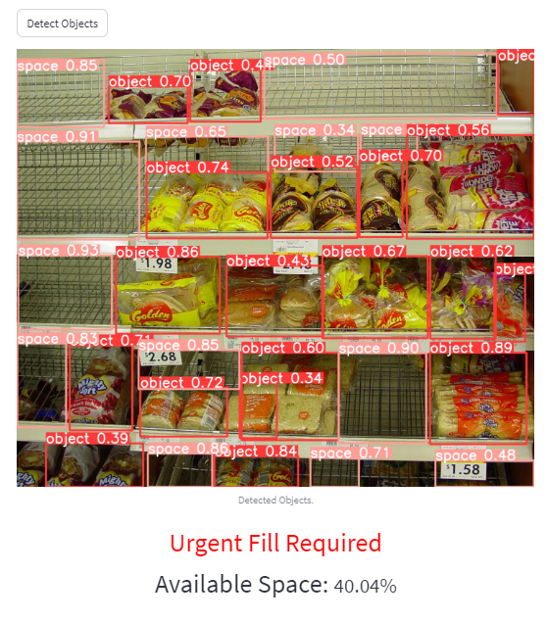
Project Development Stages
Step 7: Space Percentage Detection
Developed Space Percentage Detection Code
Categorized shelves into 3 types
Urgent Fill Required (Space>20%)
Needs Attention (10%<Space>20%)
Managed Inventory (Space<10%)
Step 8: Web Application Deployment

Slide 11
Benefits of the Space Detection MODEL
Enhanced Customer Satisfaction : Ensures products are consistently available to customers
Optimized Revenue Generation: Prevents missed revenue opportunities caused by understocked shelves
Timely Restocking Decisions: Categorization of shelves enables store managers to prioritize restocking
Reduced Stress: Helps shop owners during High sales days

Slide 12
Shelf Position Insight: Incorporating data of shelves placement within the supermarket
Product-Specific Precision: Using product data, pinpoint items with shortages or high demand
Real-Time Inventory Alerts: Integrating real-time notifications for urgent restocking needs
Enhancements and Future Possibility

Slide 13

PROJECT Challenges
Computational in-efficiency: While working on space detection, we encountered the challenge of finding the right balance between accuracy and speed in our processing.
Addressing the Challenge: Fine-tuned our model by experimenting with different settings and parameters in our algorithms. This allowed us to strike a balance between accuracy and speed, making our calculations faster without sacrificing reliability.

